Slide 1
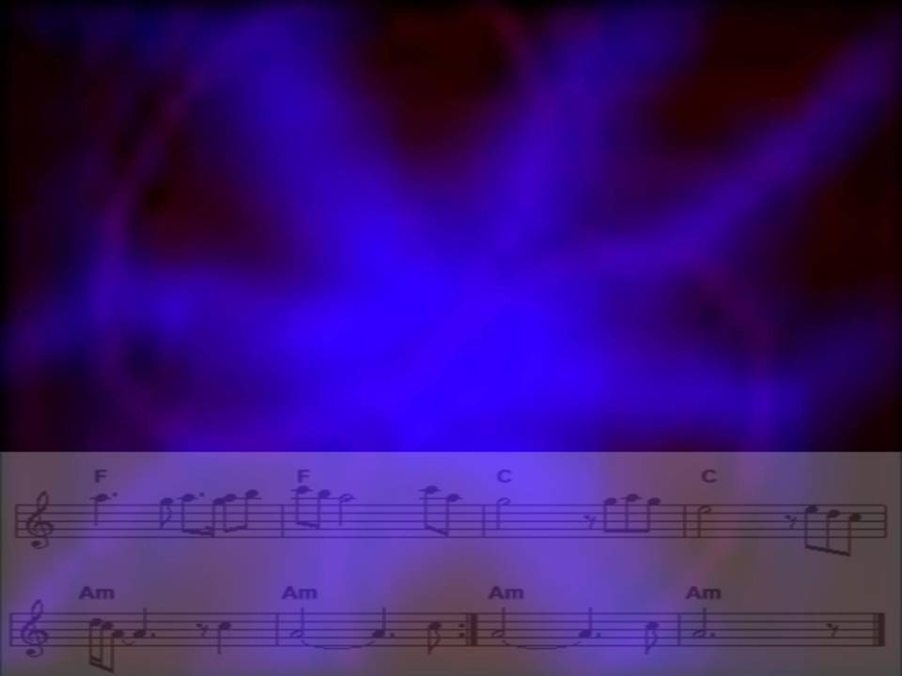
Amazing Grace
AMAZING GRACE
© John Newton
Used with permission: CCLI 20931

Slide 2
Amazing Grace
How sweet the sound
That saved a wretch like me
I once was lost
But now am found
Was blind but now I see
Notes:
Verse 1

Slide 3
T’was grace that taught
My heart to fear
And grace my fears relieved
How precious did that
Grace appear
The hour I first believed
Notes:
Verse 2

Slide 4
Through many dangers
Toils and snares
I have already come
‘Tis grace that brought me
safe thus far
And grace will lead me home
Notes:
Verse 3

Slide 5
When we’ve been there
Ten thousand years
Bright shining as the sun
We’ve no less days
To sing God’s praise
Than when we first begun
Notes:
Verse 4

